Slide 1


Notes:
Chara

Slide 2
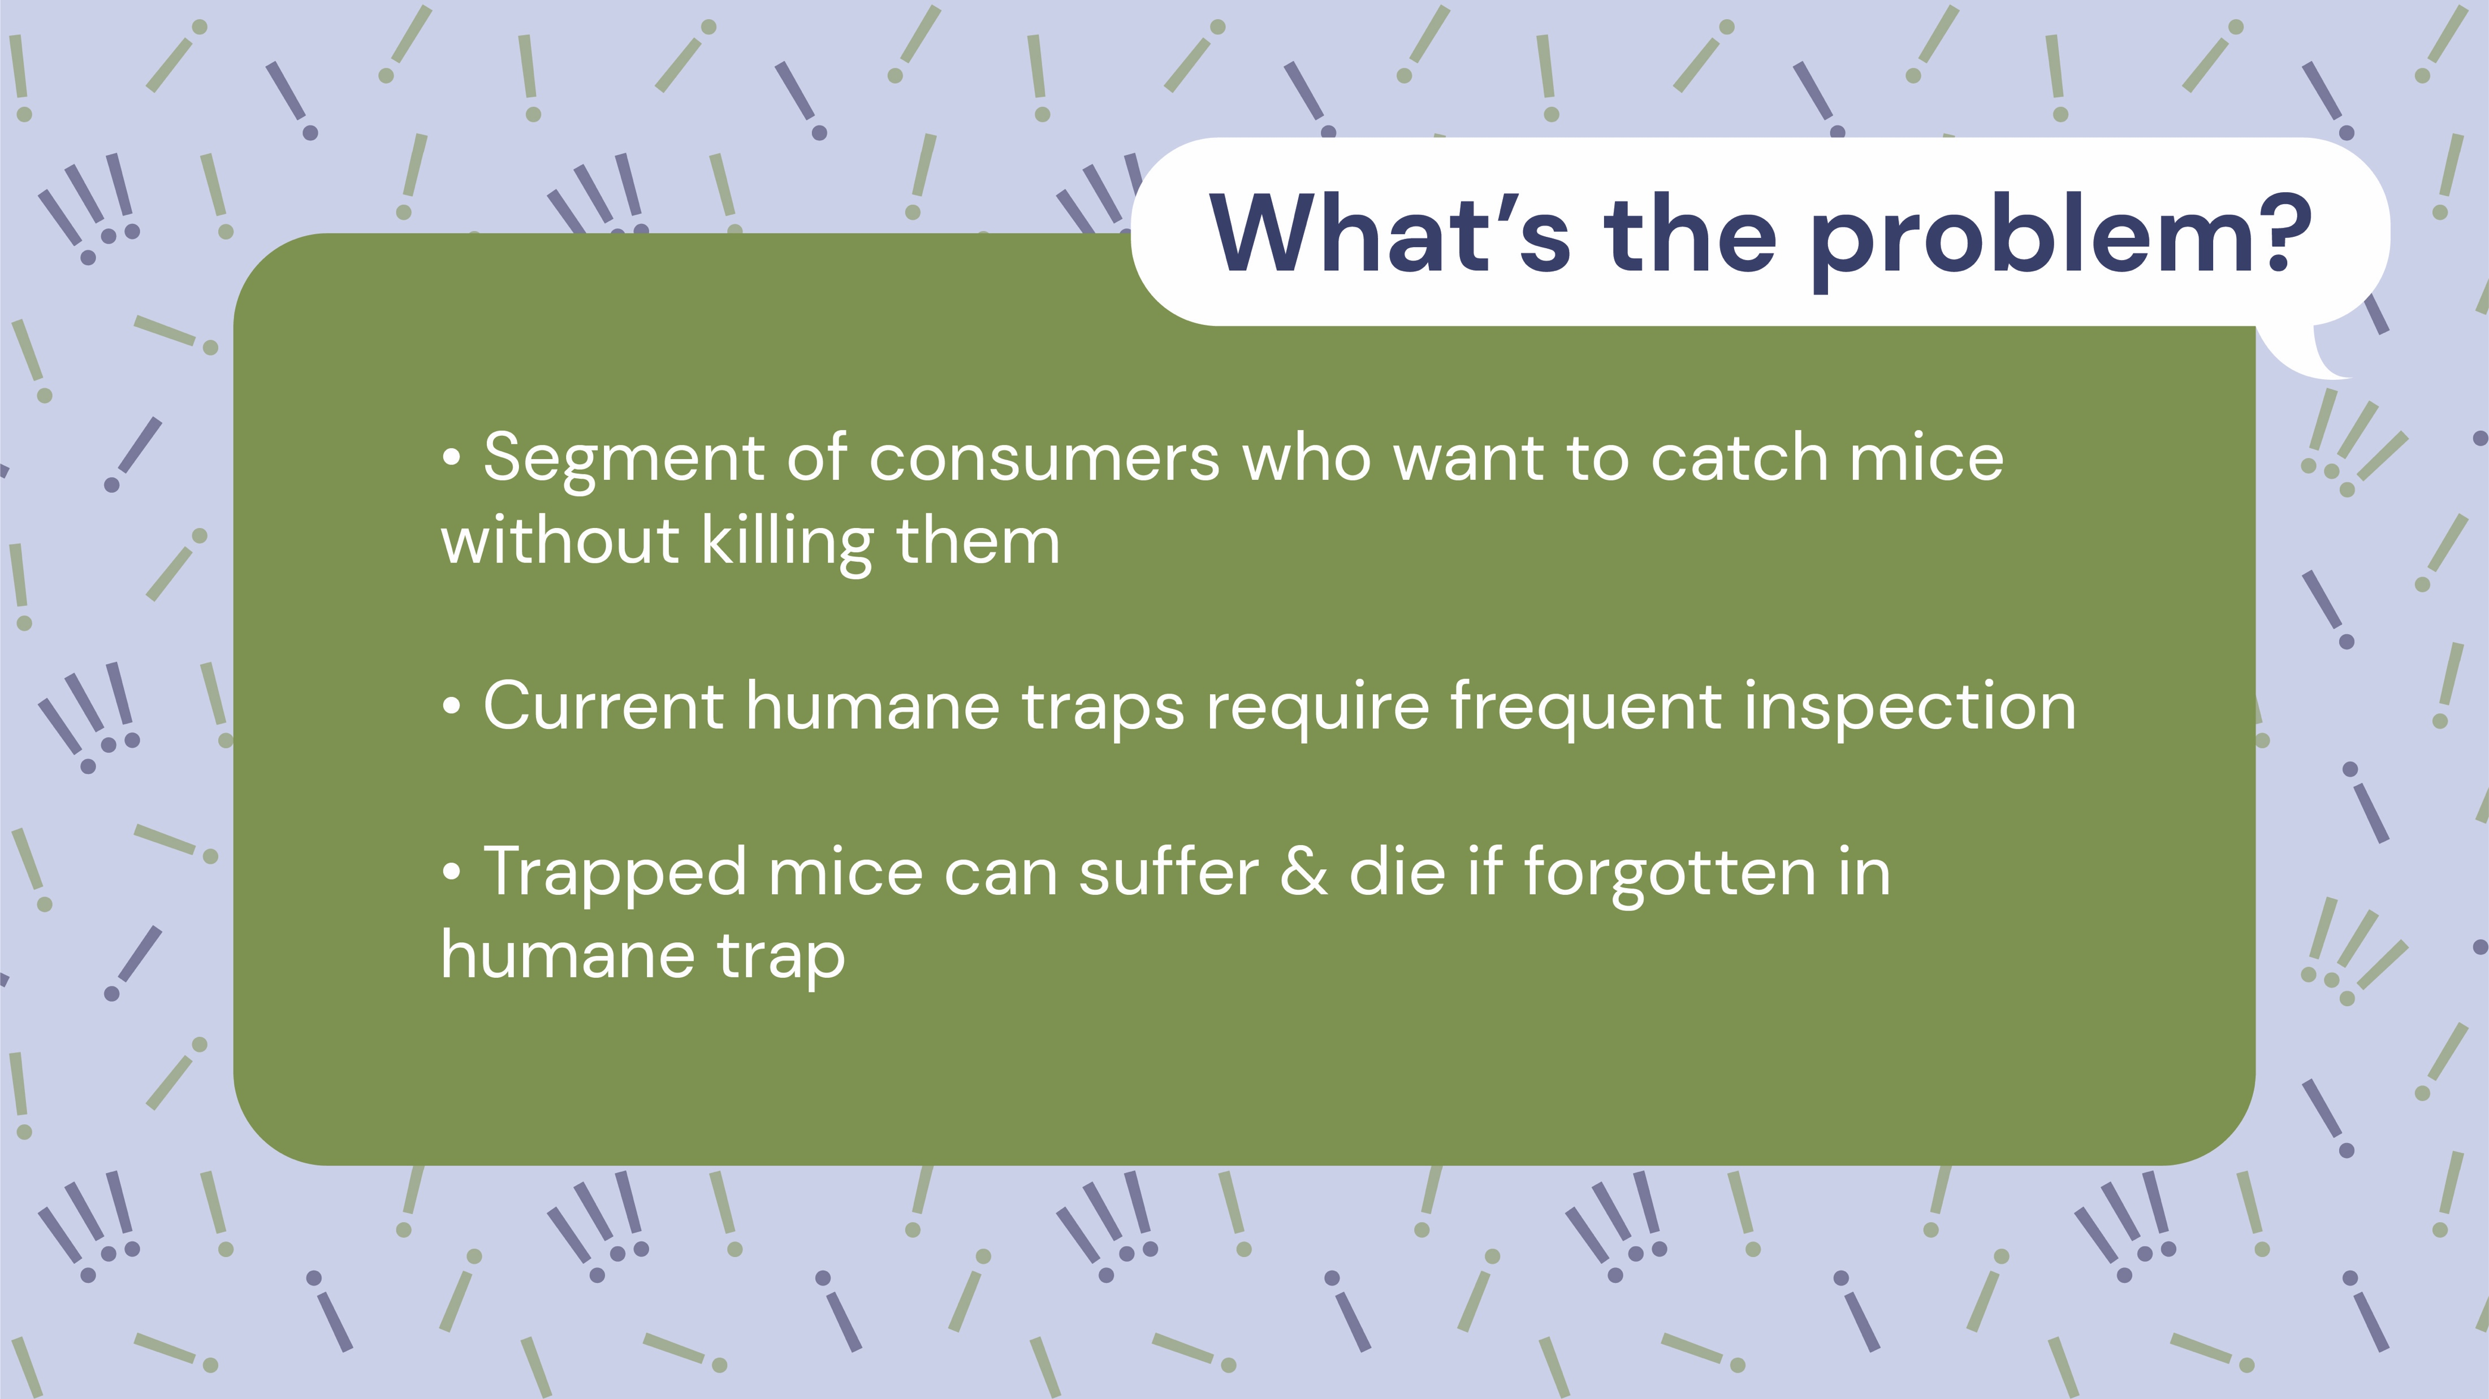

Notes:
CHara

Slide 3


Notes:
Chara

Slide 4

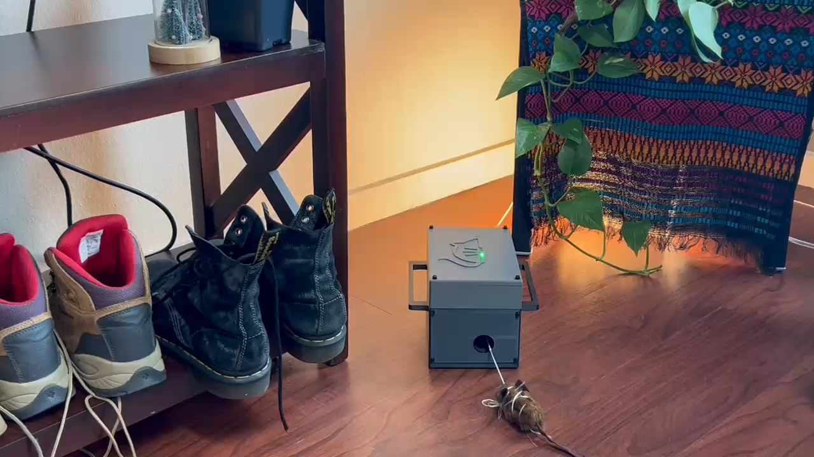
Notes:
Chara

Slide 5
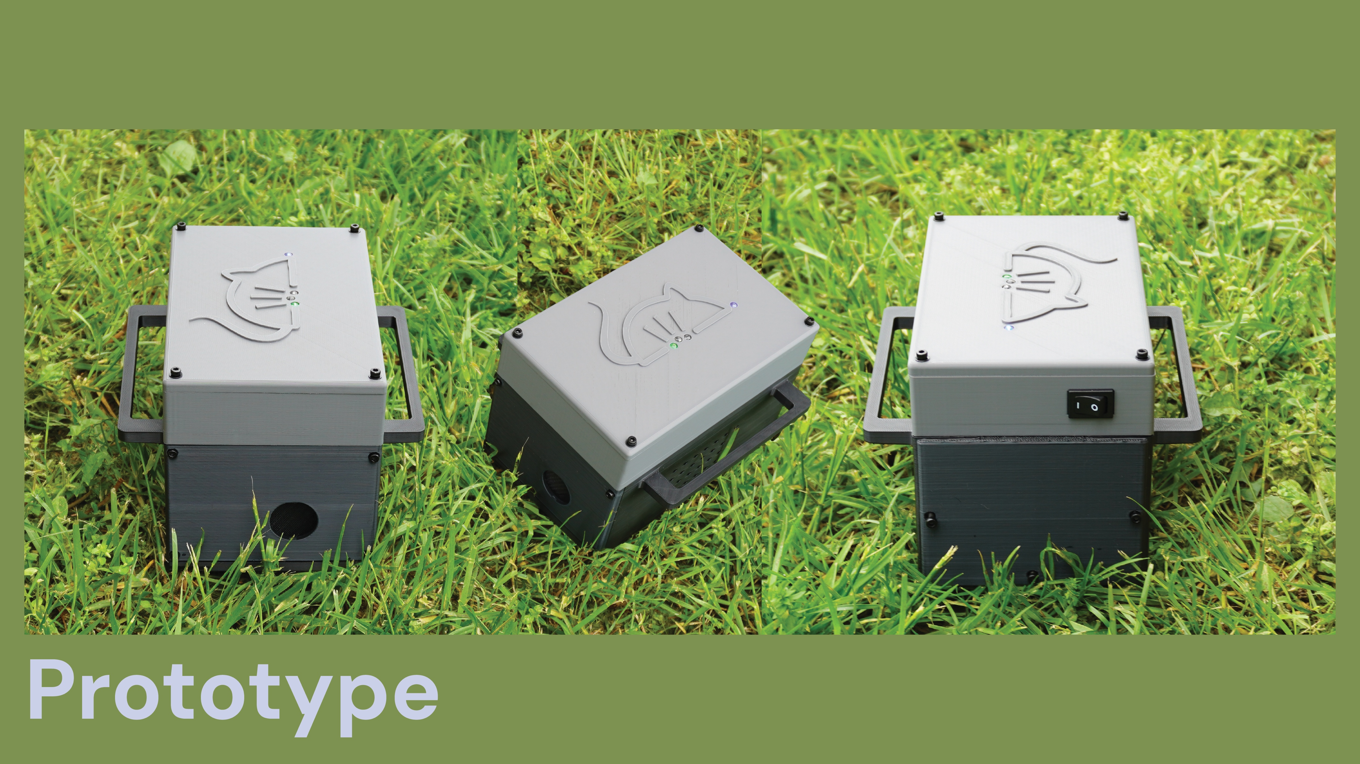
Notes:
Chara

Slide 6
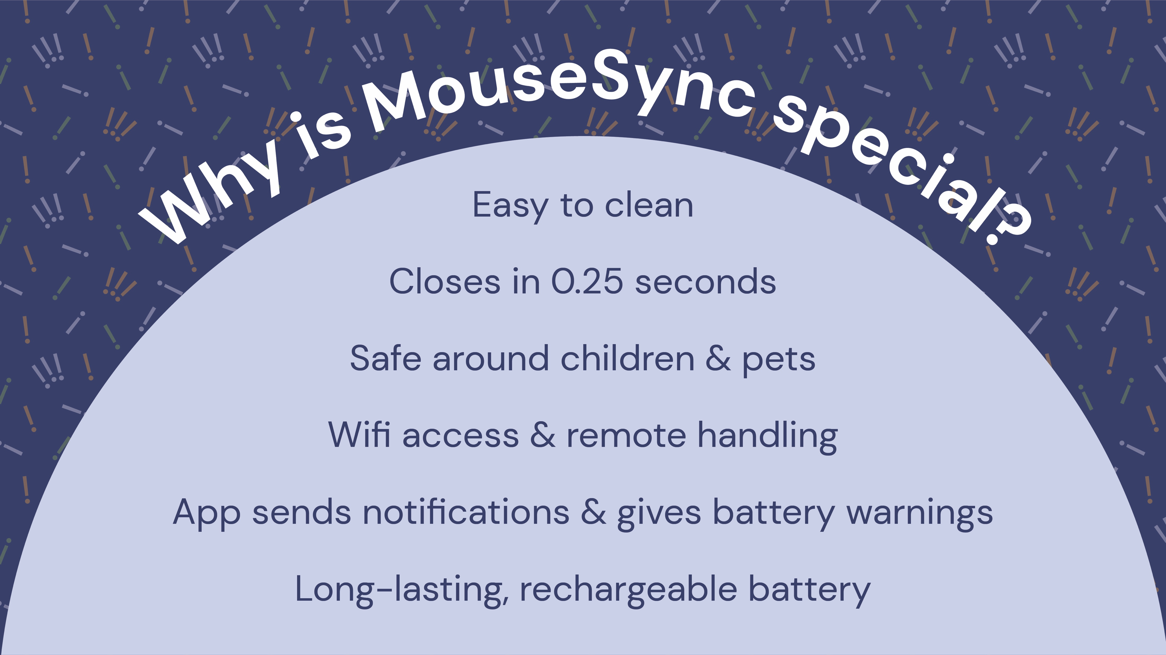
Notes:
Kailyn: So what makes MouseSync so special? First of all, if you want a functioning trap: we give you a trap that closes in .25s and can last you up to 16 days between charges, and as long as you need if plugged in! It has remote access through wi-fi so on top of getting mouse status notifications, you can release the mouse from the safety of your car! Its removable back wall also allows an easy clean, but best of all, our design choices guarentee a safe experience for your pets, your children, and you fingers, ! So how do we do this?

Slide 7

Notes:
Kailyn : Let's look at our production schematics.

Slide 8

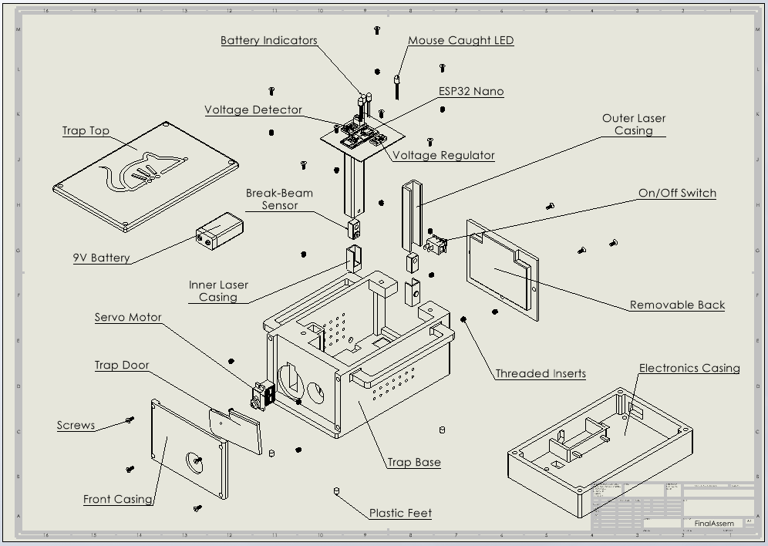
Notes:
CHara

Slide 9
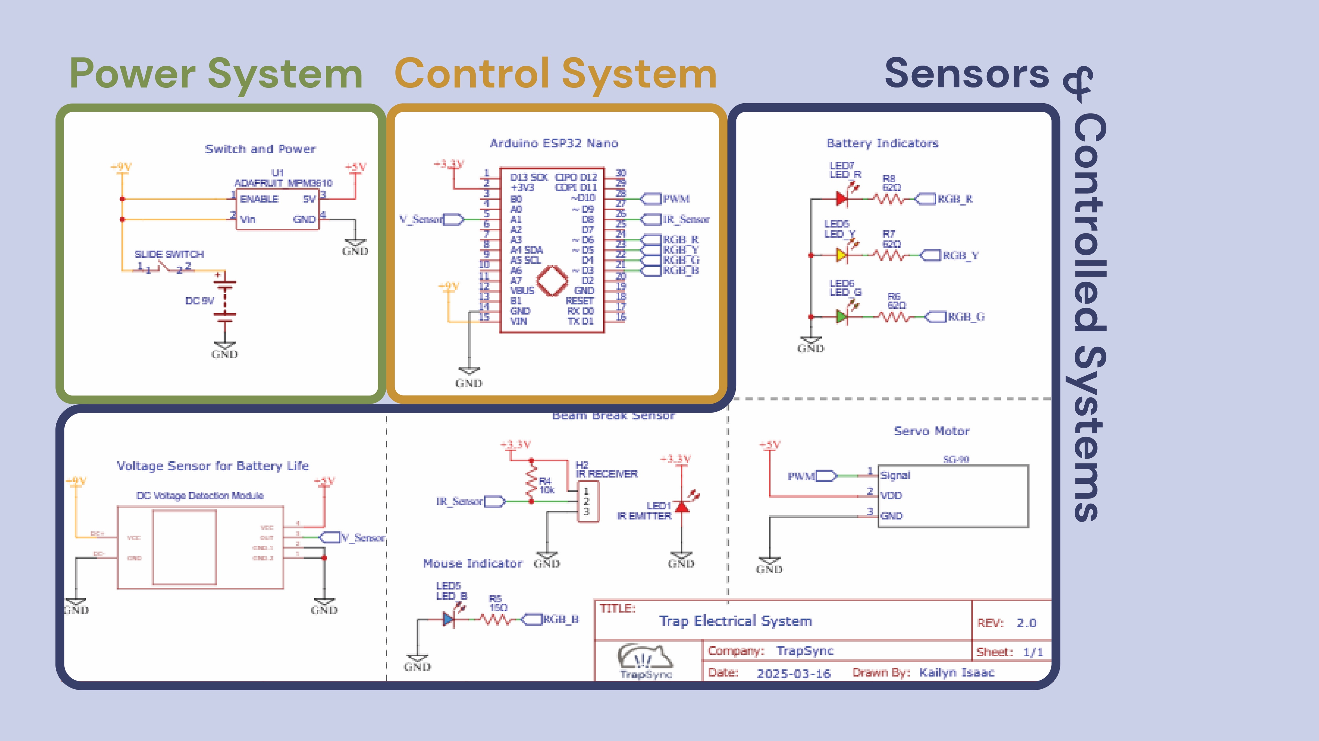
Notes:
Kailyn: On the electrical side, We have three different systems: The power system includes a rechargeable battery with high capacity for a long-lasting trap, the control system is the central system with wi-fi abilities and fast reaction interrupts; and the Sensors and controlled systems include an infrared beam sensor, LEDs for physical battery and detection indicators, and the trap door motor. You can look more closely at this schematic in the folder.

Slide 10
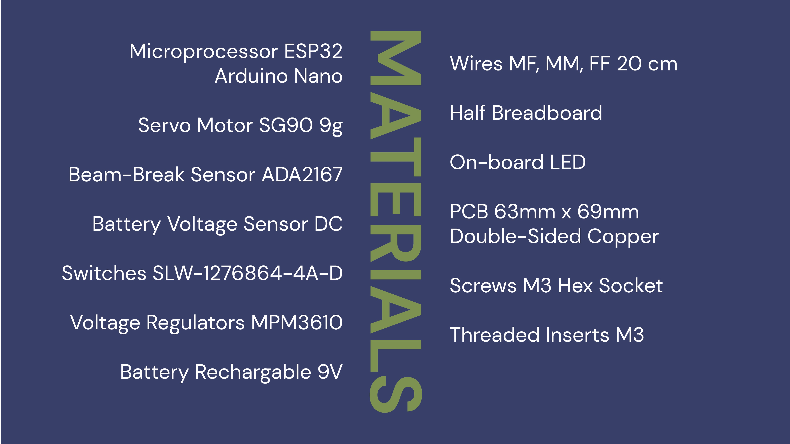
Notes:
Kailyn: Among the materials, the standout is the ESP32 Arduino Nano. In addition to built-in Wi-Fi capabilities, its compatibility with the Arduino IDE provides a seamless entry into open-source development, empowering users to customize and enhance their traps with ease.

Slide 11
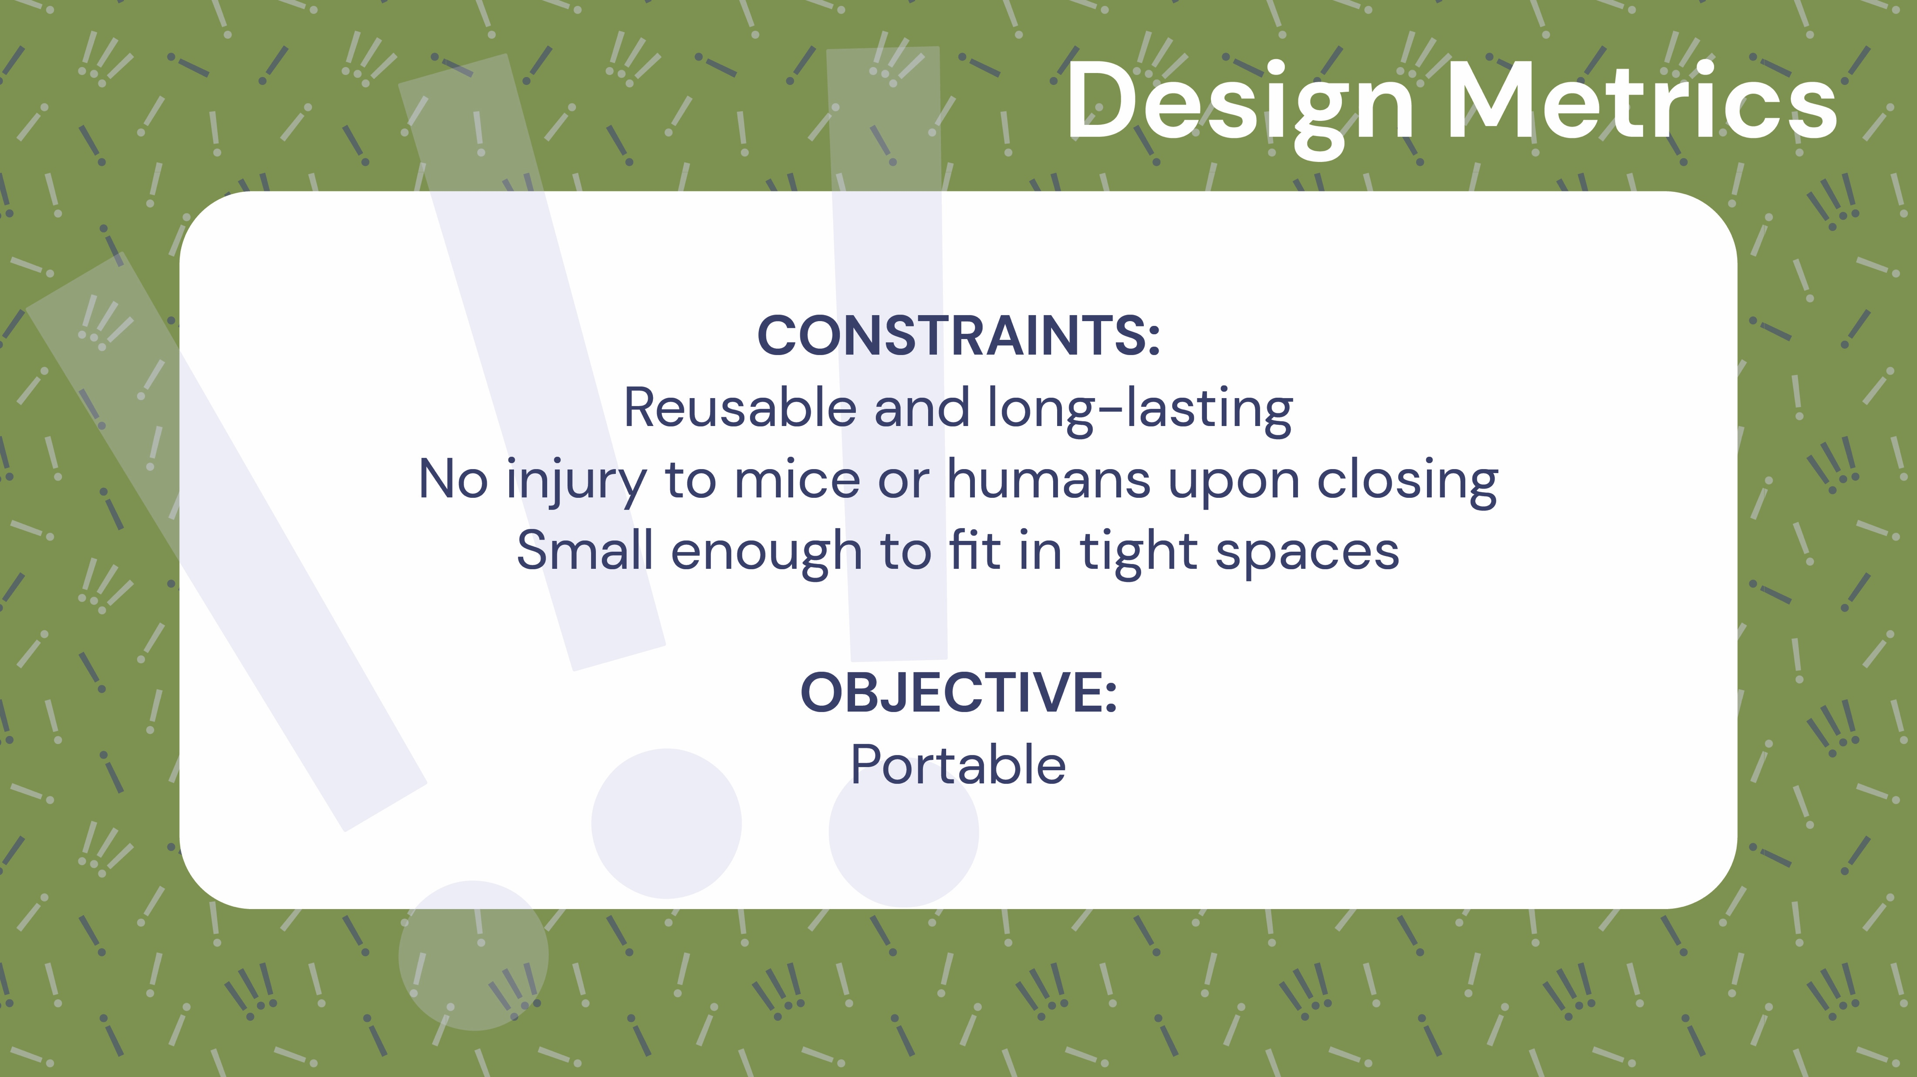
Notes:
Chara

Slide 12
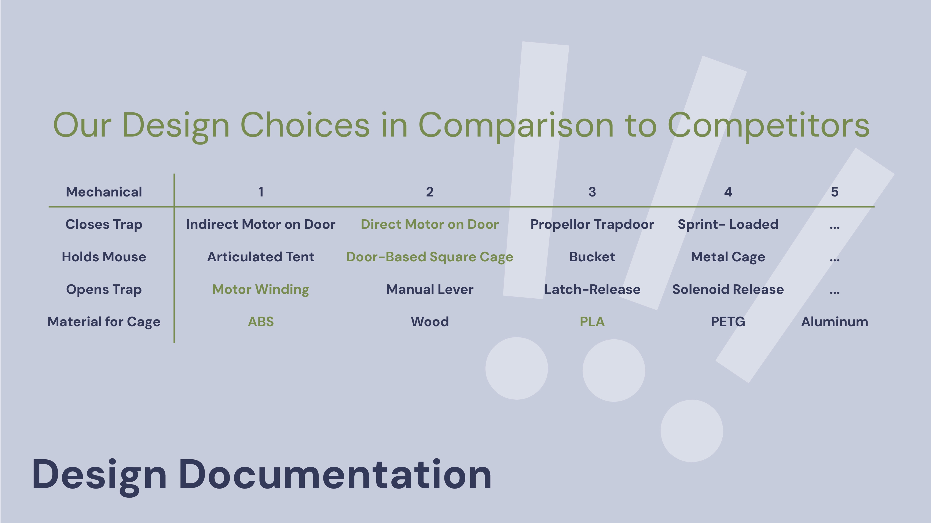
Notes:
Chara:

Slide 13

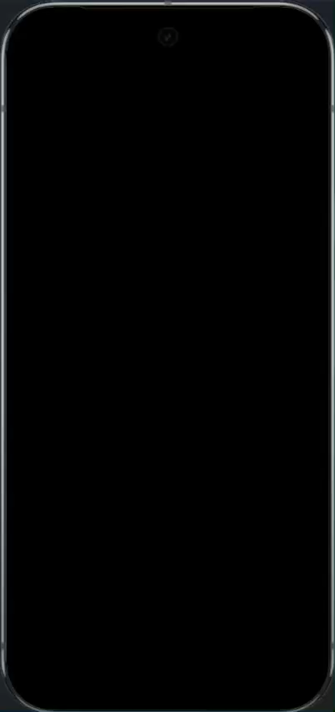
Notes:
Kailyn: Now let's focus on the app. The user has access to a trap page, a notification history of the trap alerts that comes with pop-up notifications, troubleshooting tips, drop-off locations and their user profile. After opening up the app, the user signs in and is faced with the main page where traps can be added, named, deleted. Each have their individual battery levels and mouse caught status and the user can remotely release the mouse as well as reset the trap to be ready to catch again.

Slide 14
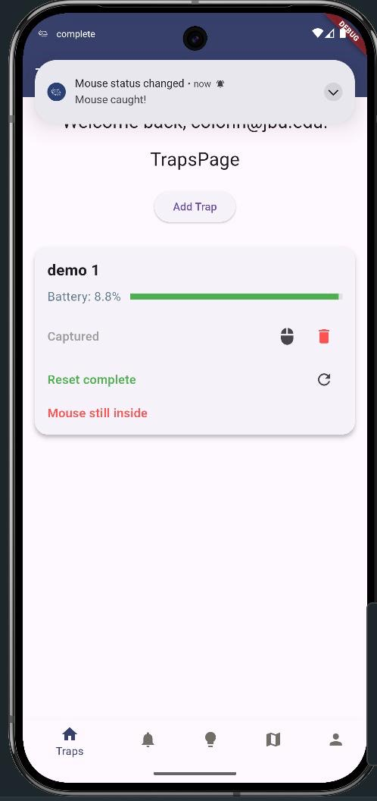
Notes:
Kailyn: Now let's focus on the app. The user has access to a trap page, a notification history of the trap alerts that comes with pop-up notifications, troubleshooting tips, drop-off locations and their user profile. After opening up the app, the user signs in and is faced with the main page where traps can be added, named, deleted. Each have their individual battery levels and mouse caught status and the user can remotely release the mouse as well as reset the trap to be ready to catch again.

Slide 15
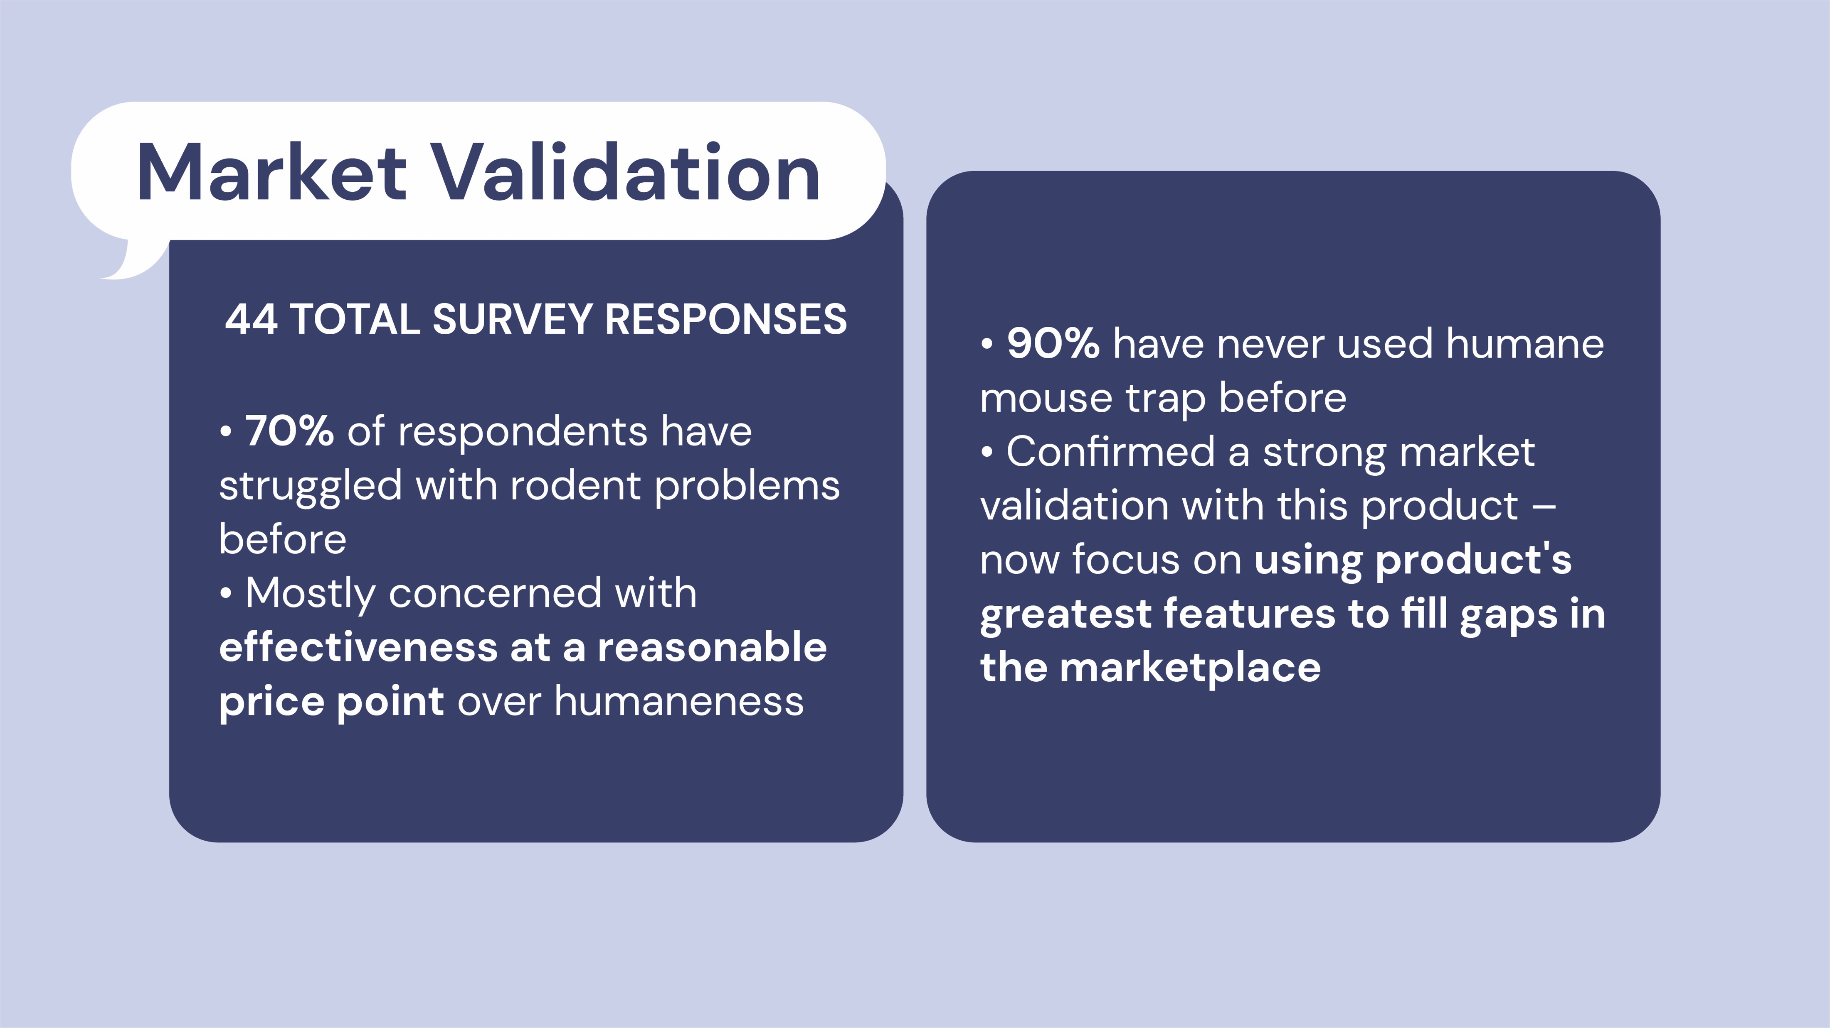

Slide 16
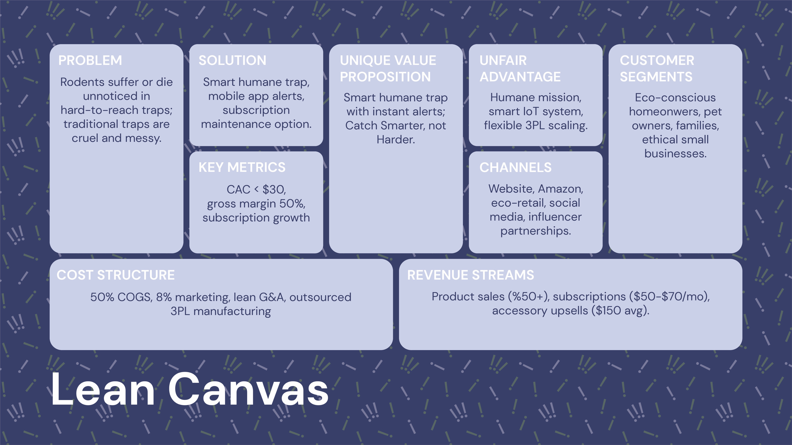

Slide 17
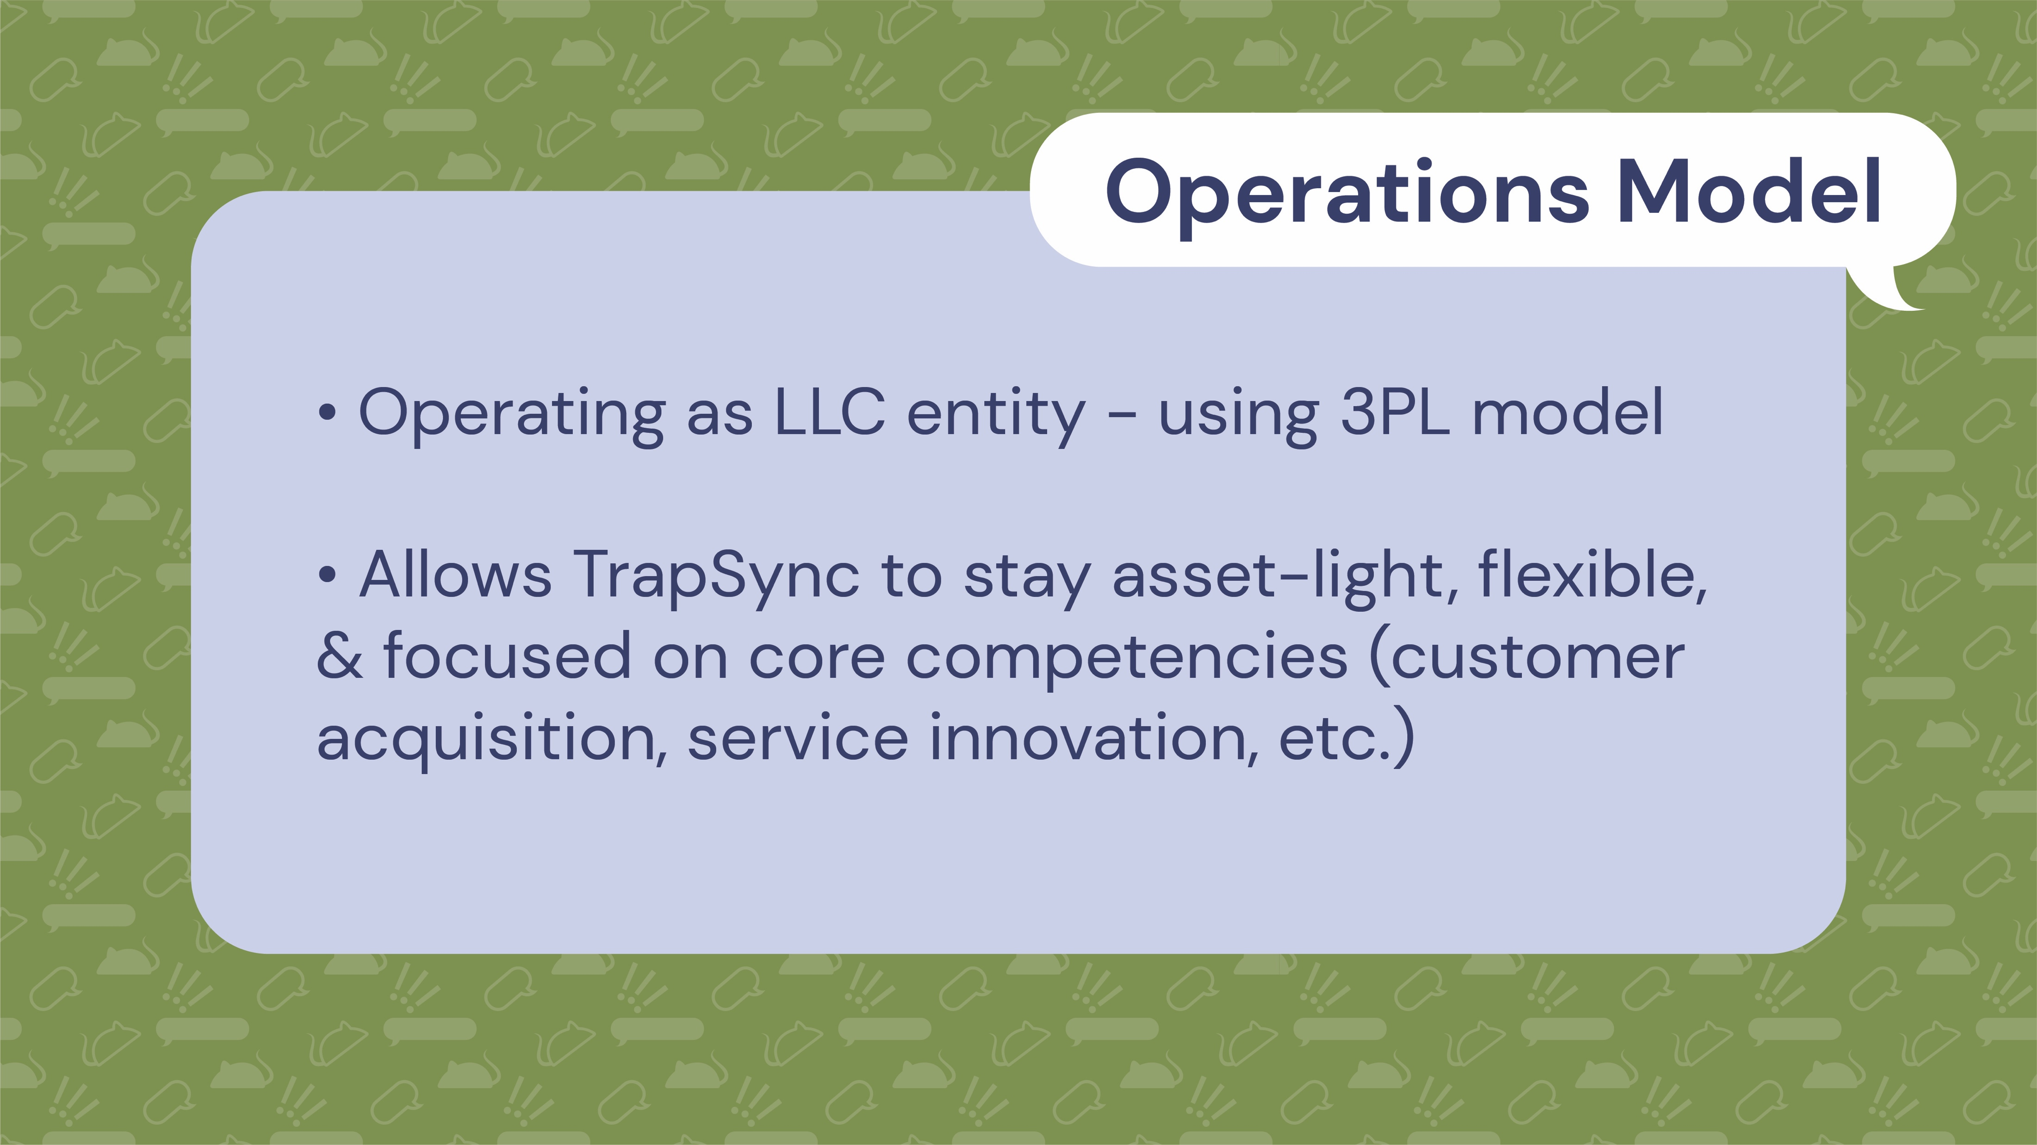

Slide 18
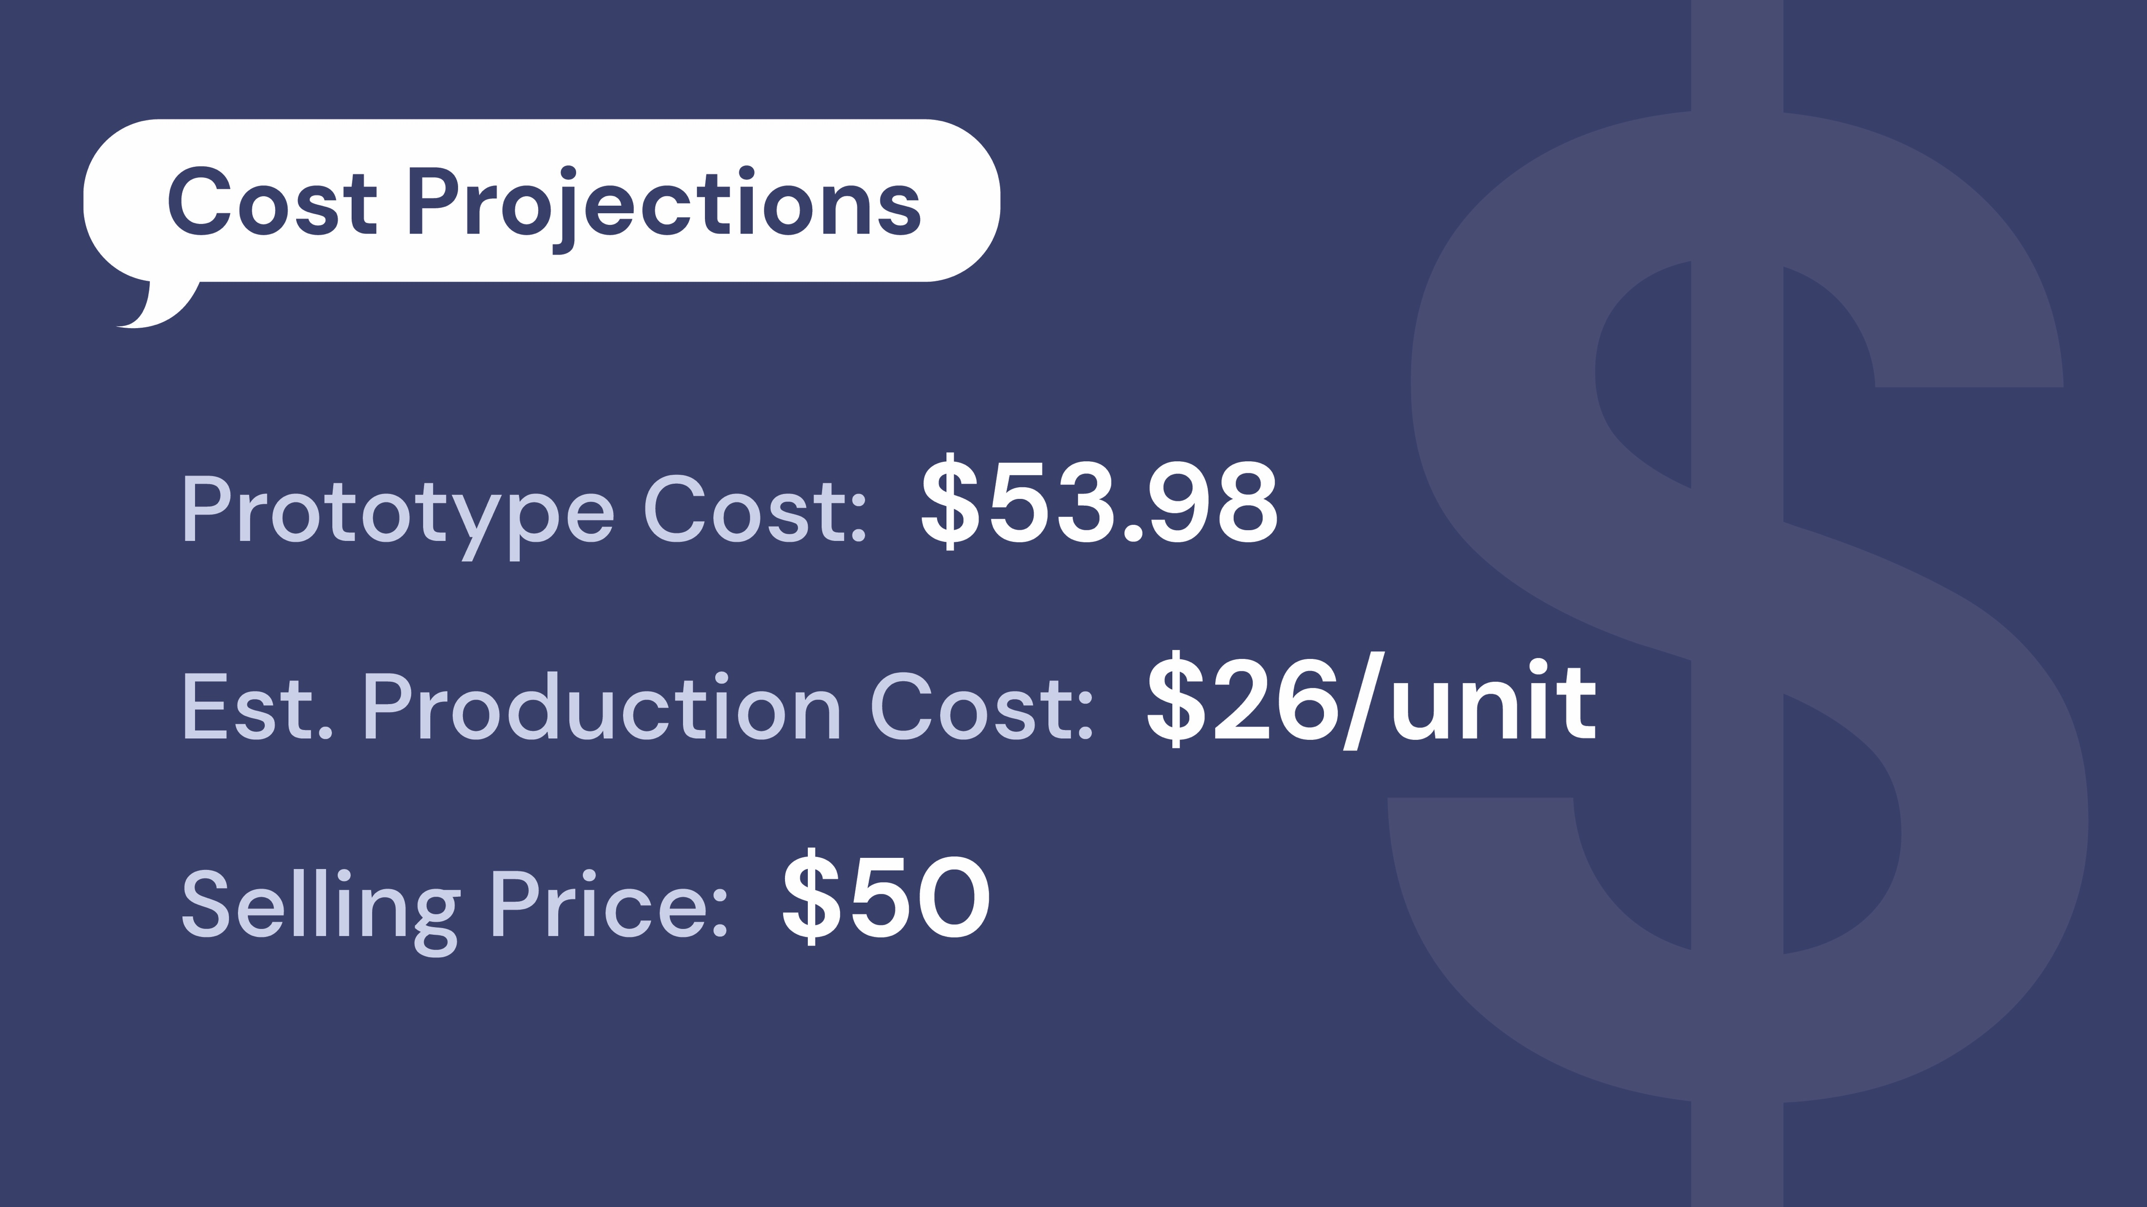

Slide 19

Notes:
MEGAN

Slide 20

Notes:
MEGAN

Slide 21
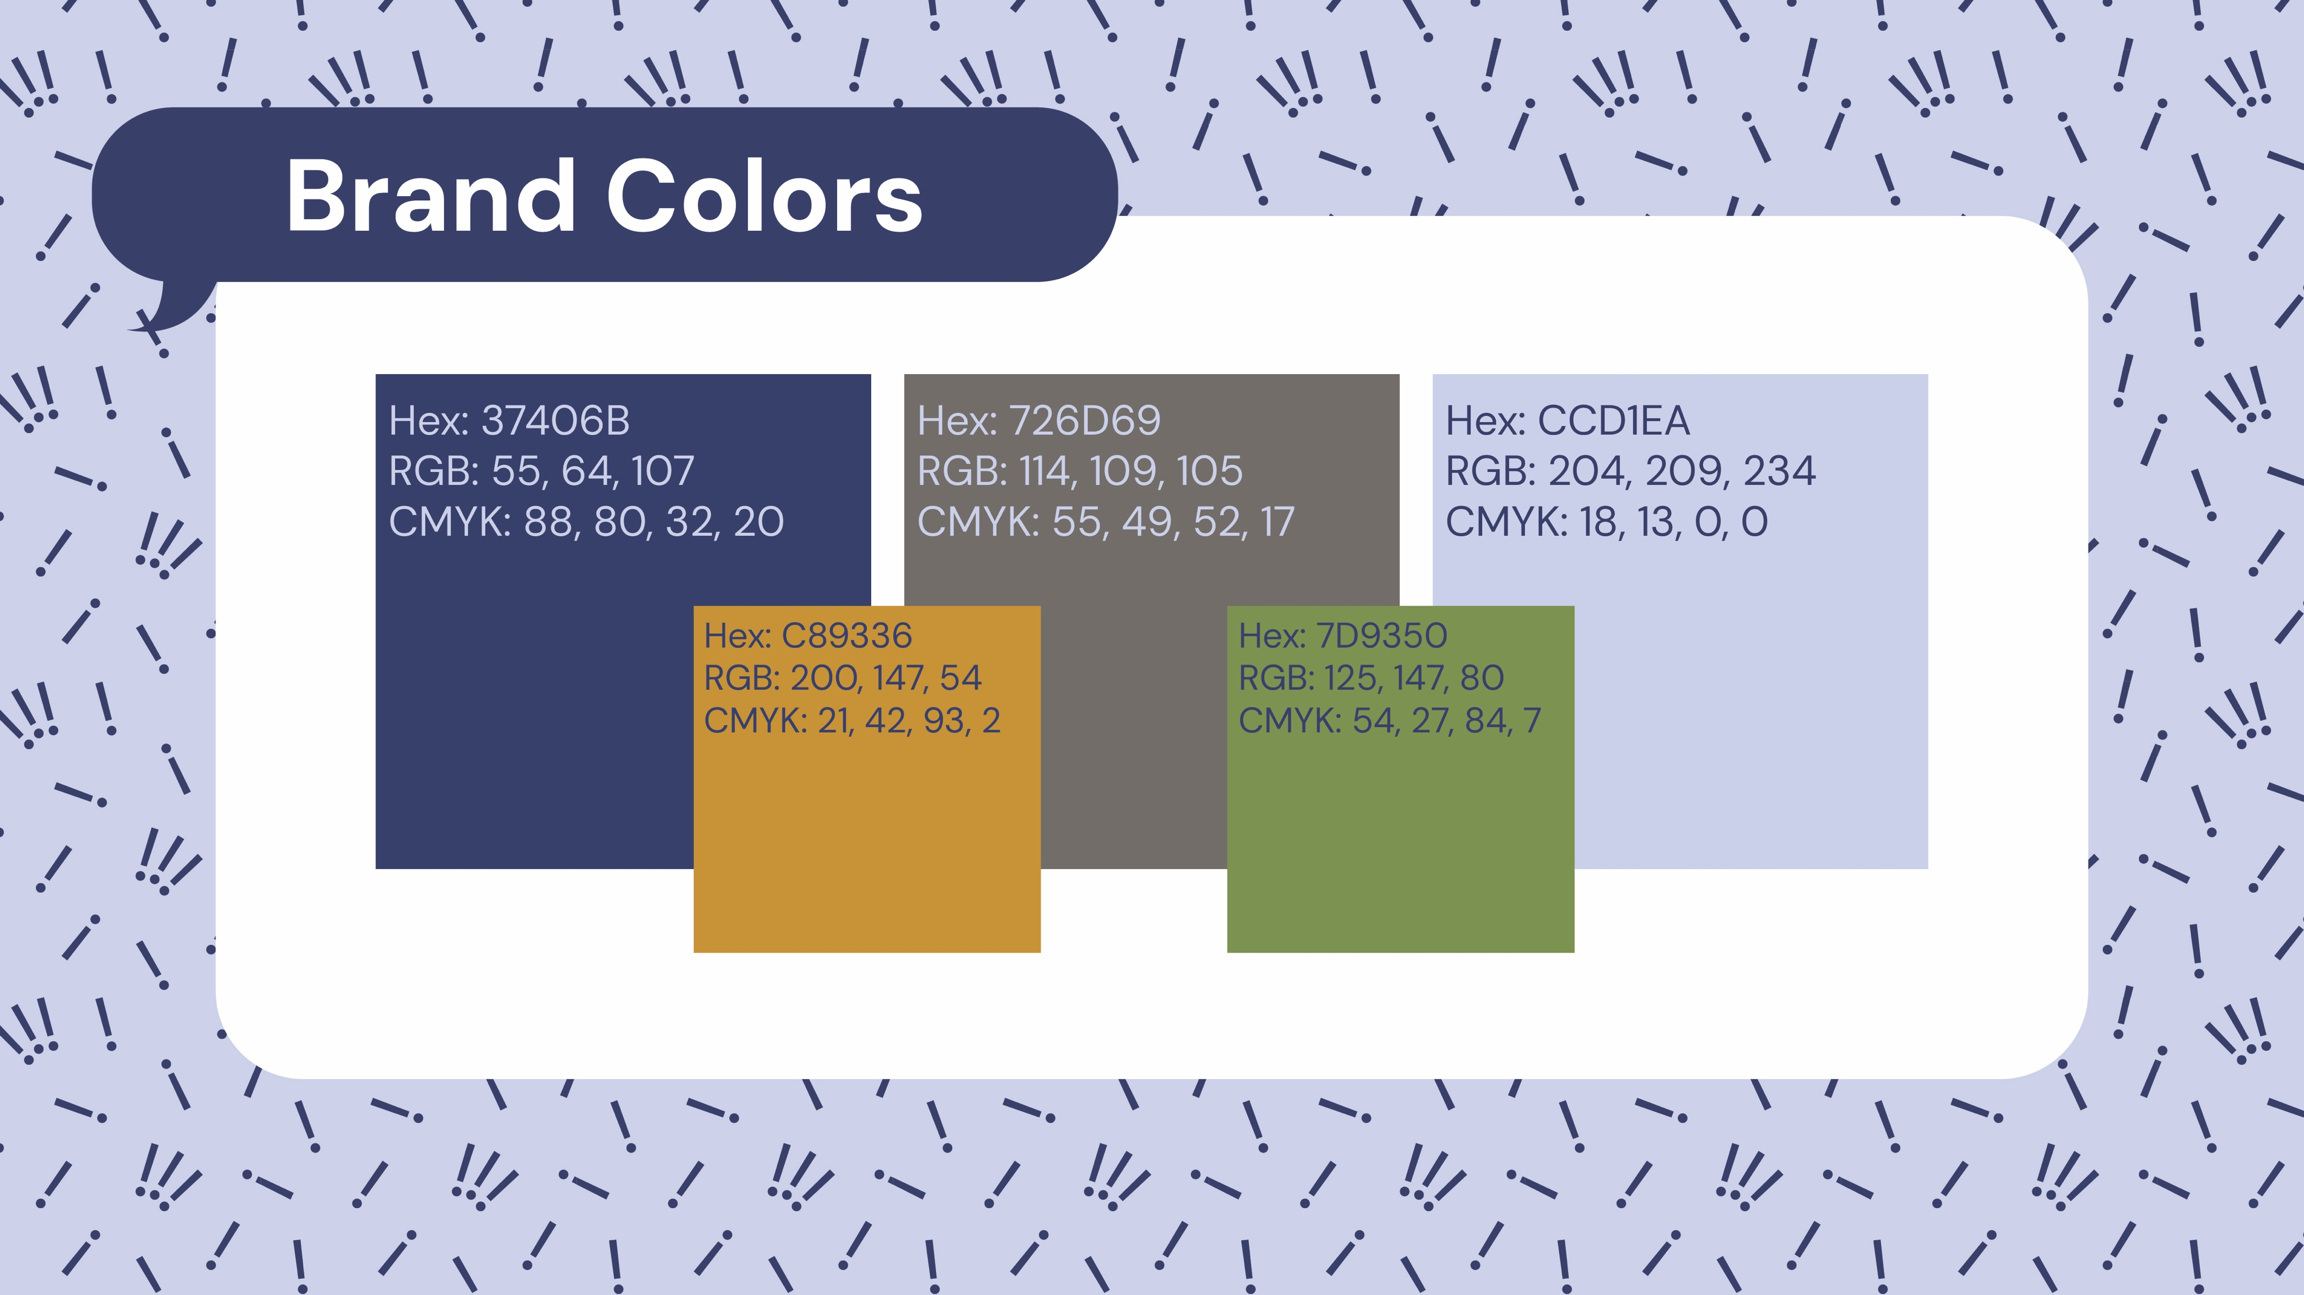
Notes:
MEGAN

Slide 22

Notes:
MEGAN

Slide 23

Notes:
MEGAN

Slide 24

Notes:
MEGAN

Slide 25
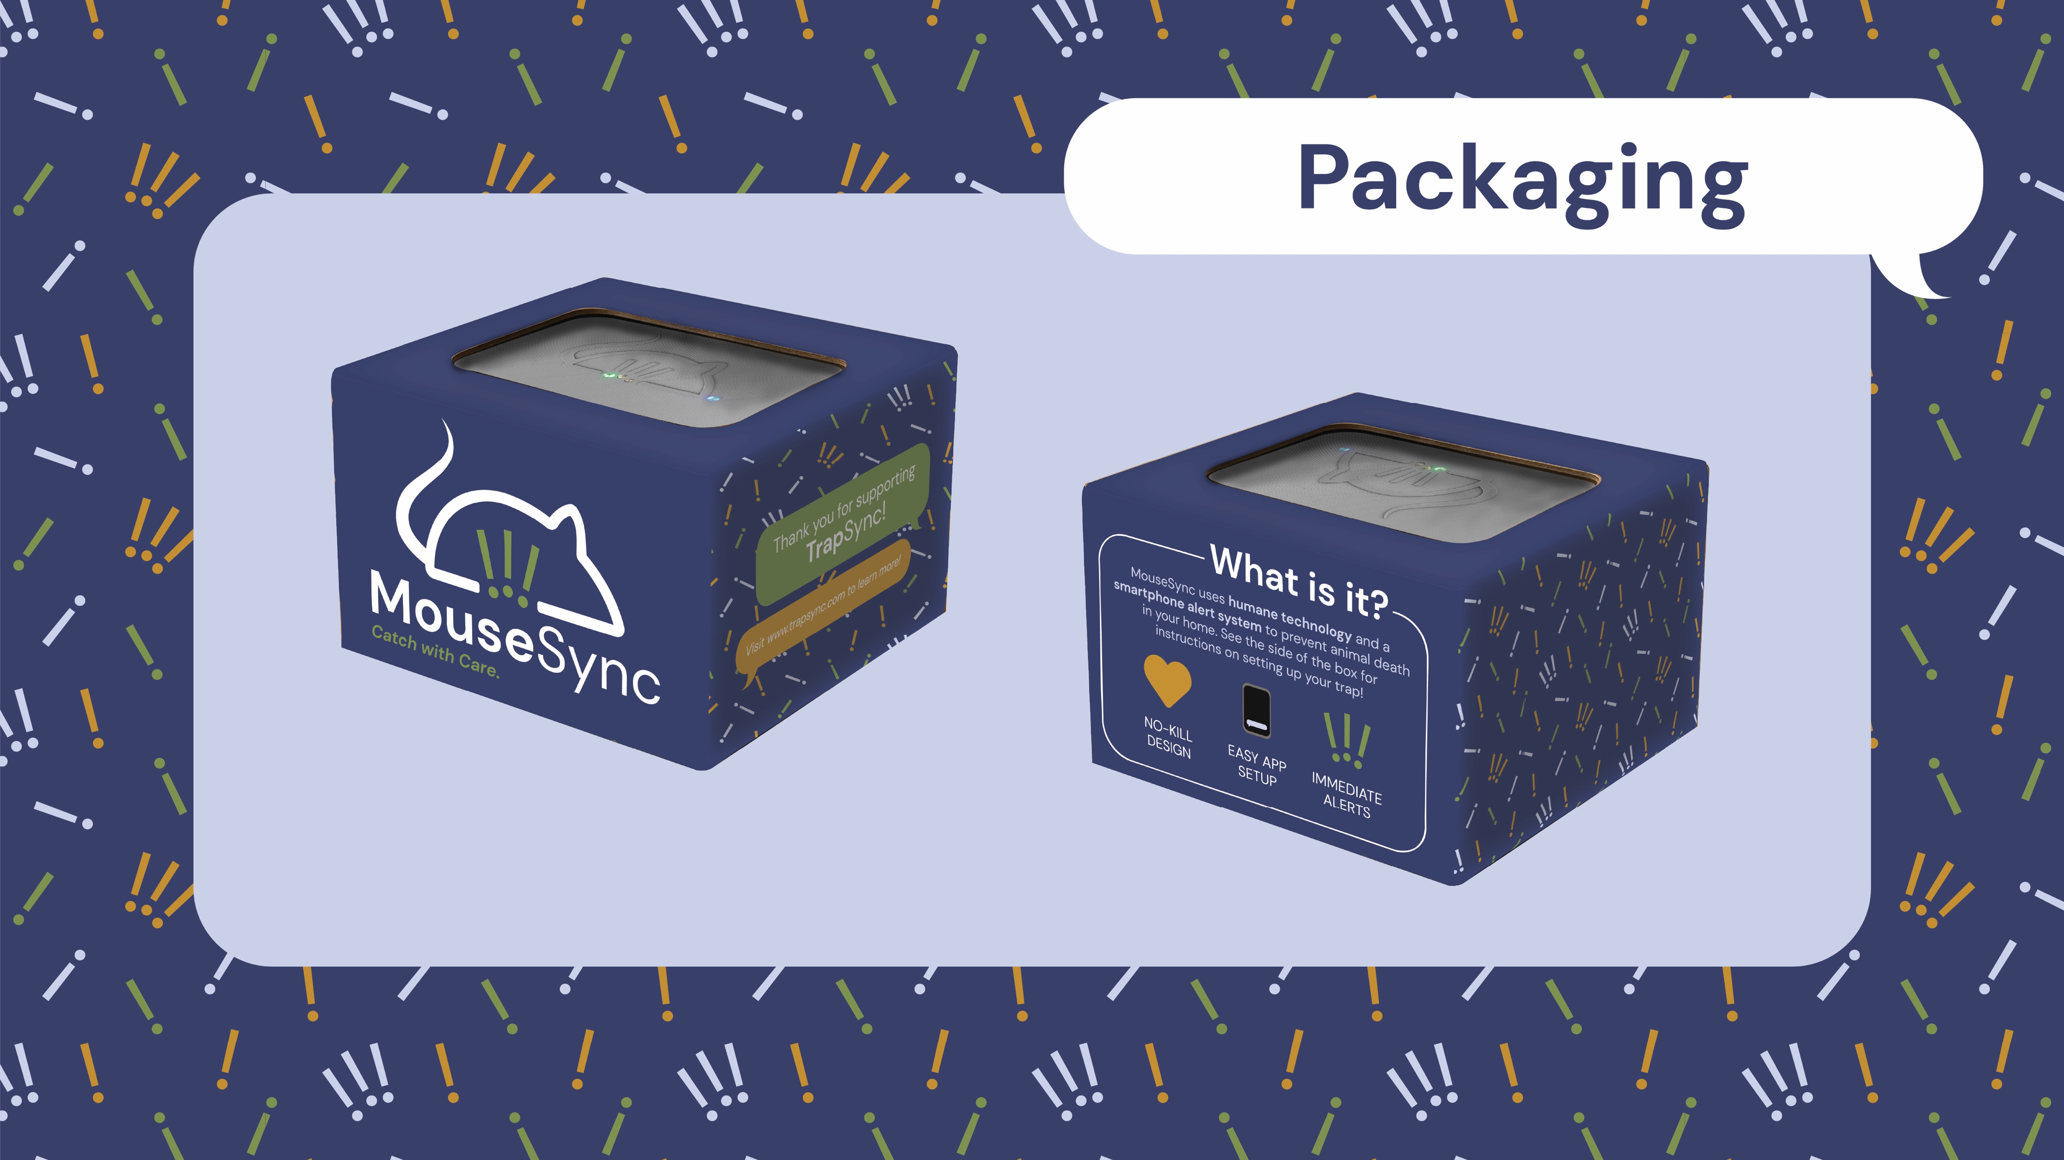
Notes:
MEGAN

Slide 26
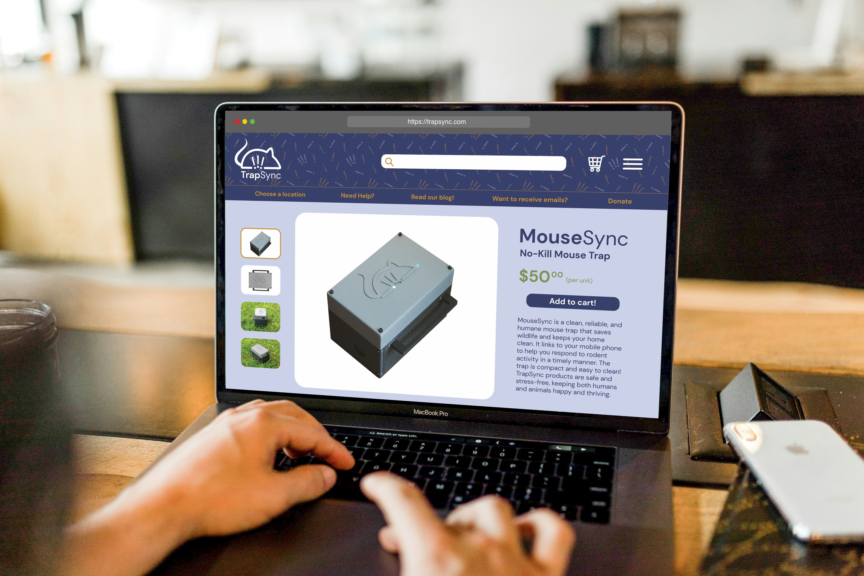
Notes:
MEGAN

Slide 27

Notes:
MEGAN

Slide 28


Notes:
Talk about Instagram that also has photos in storefront and marketing on billboards, etc. etc.

Slide 29


Slide 30


Slide 31
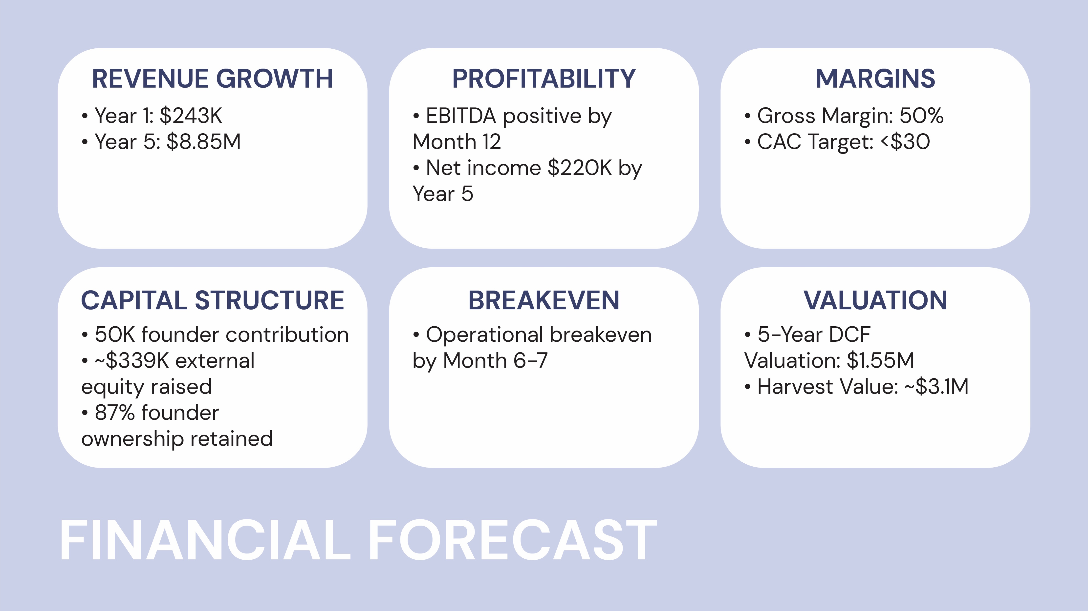


Slide 32
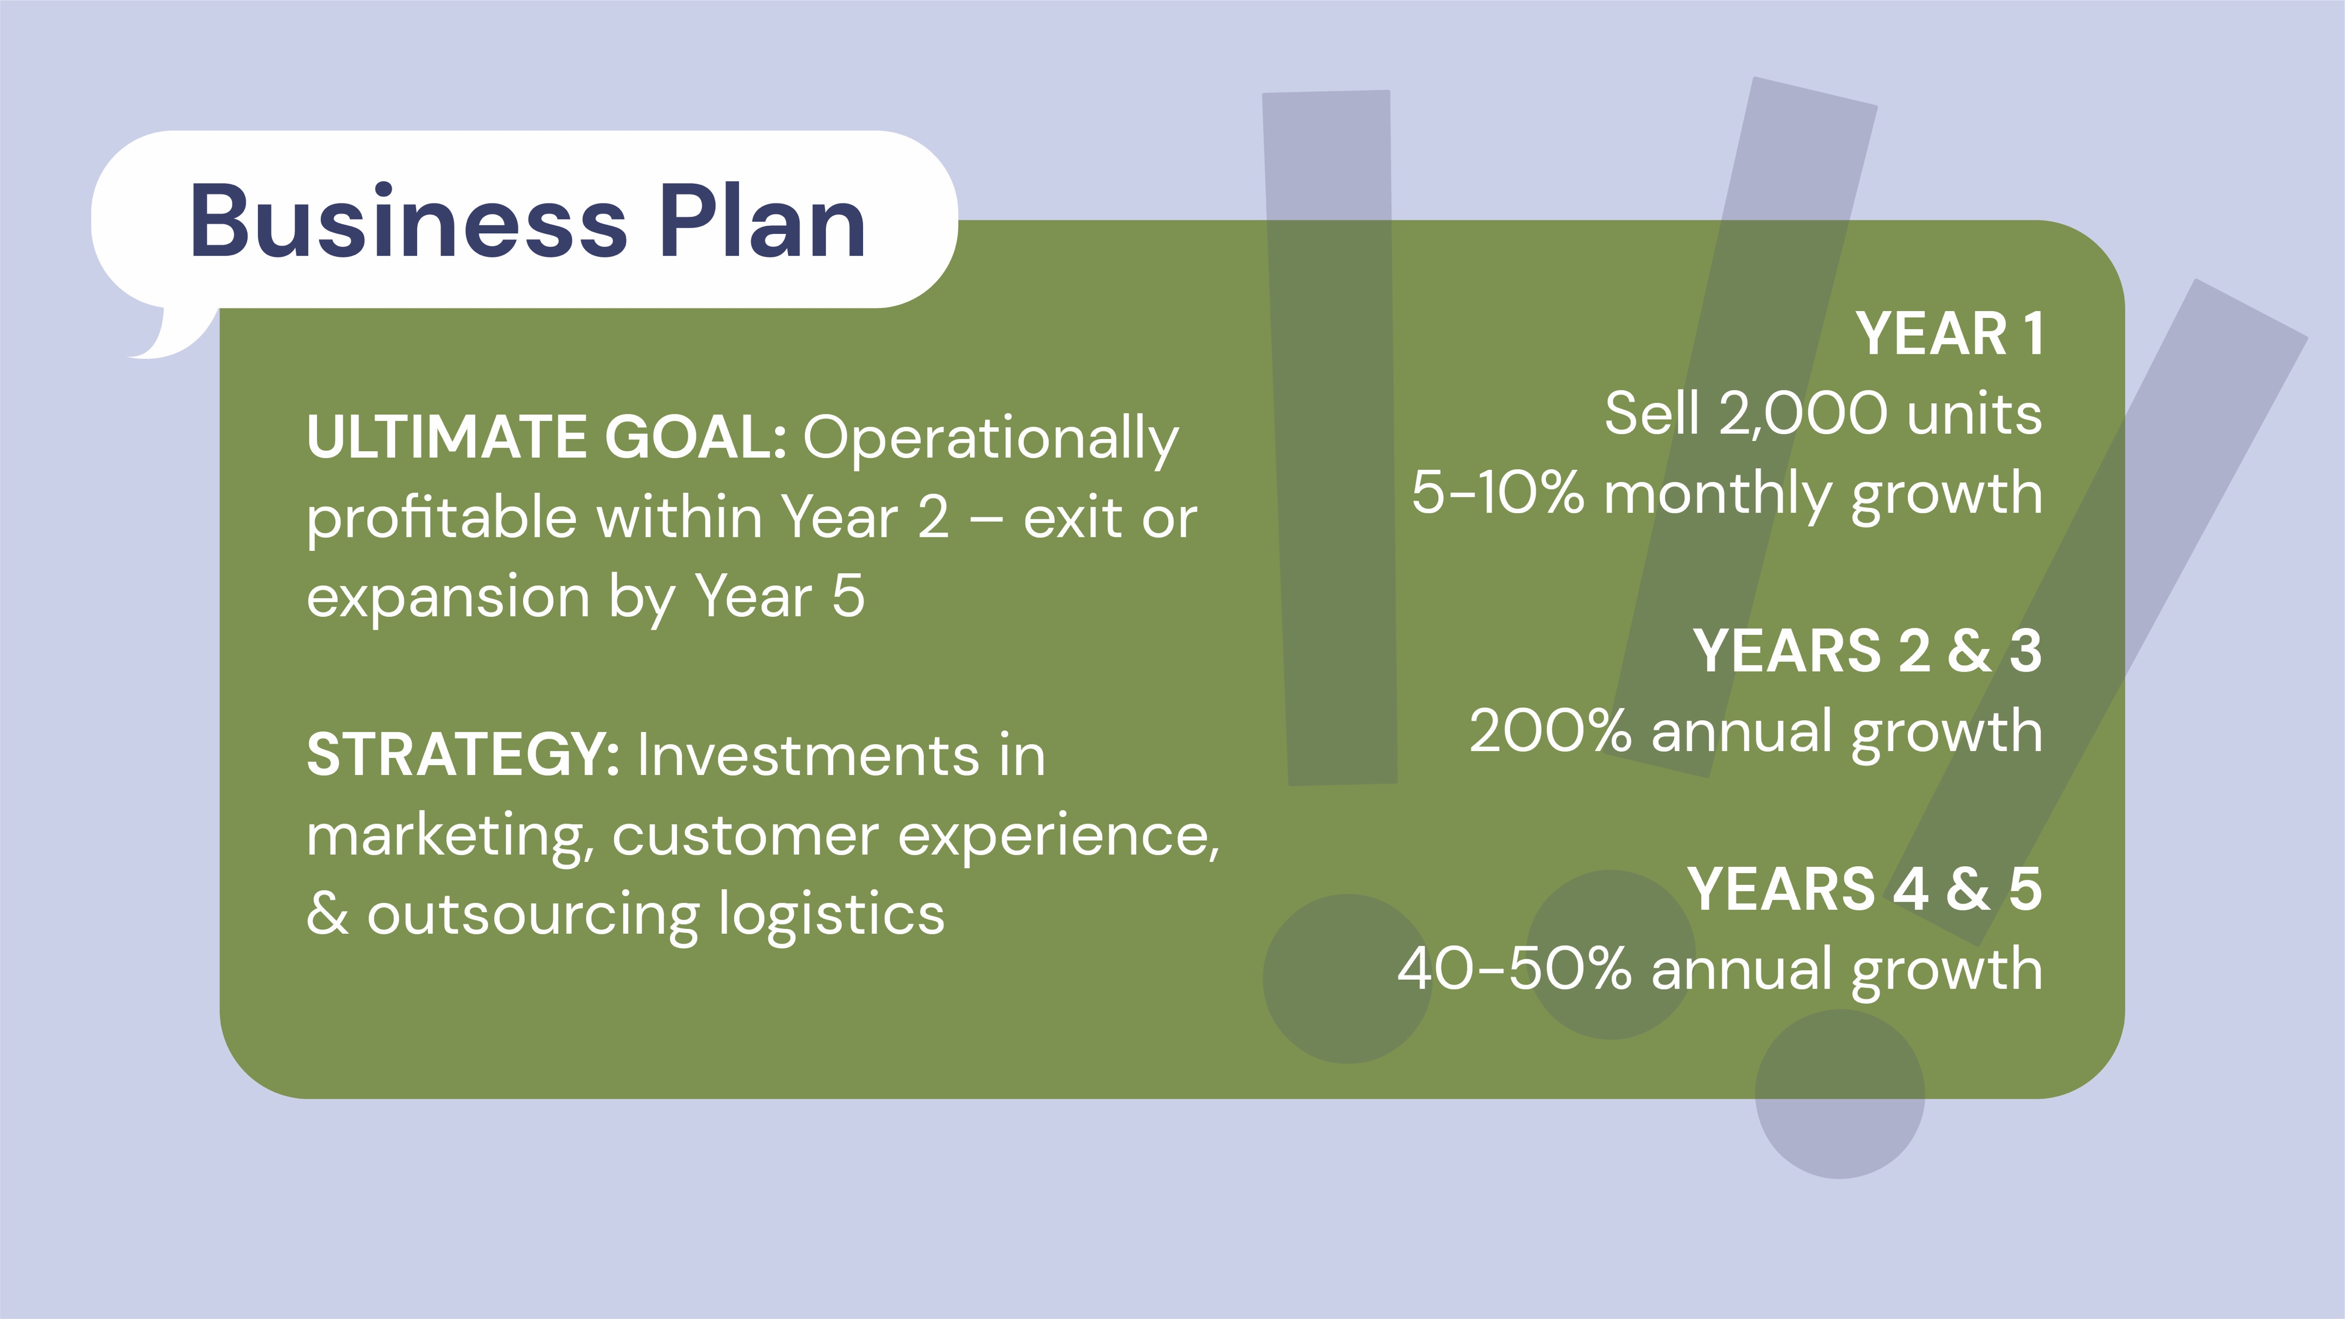

Slide 33

Notes:
-Kailyn: Let's look at the future of TrapSync

Slide 34
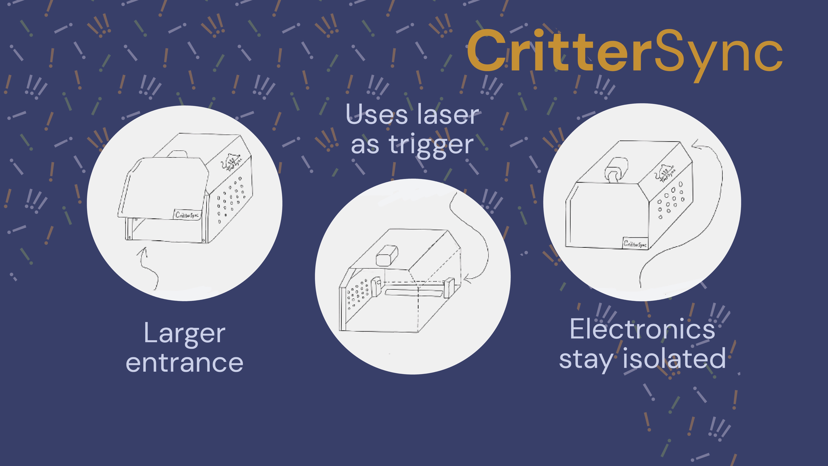
Notes:
Kailyn: Our company has the potential to expand to bigger, better traps. We're already planning CritterSync—designed for larger pests like armadillos and opossums, which are a major issue in Northwest Arkansas. Looking ahead, this expansion could even include rooftop installations for managing endangered bat species.

Slide 35
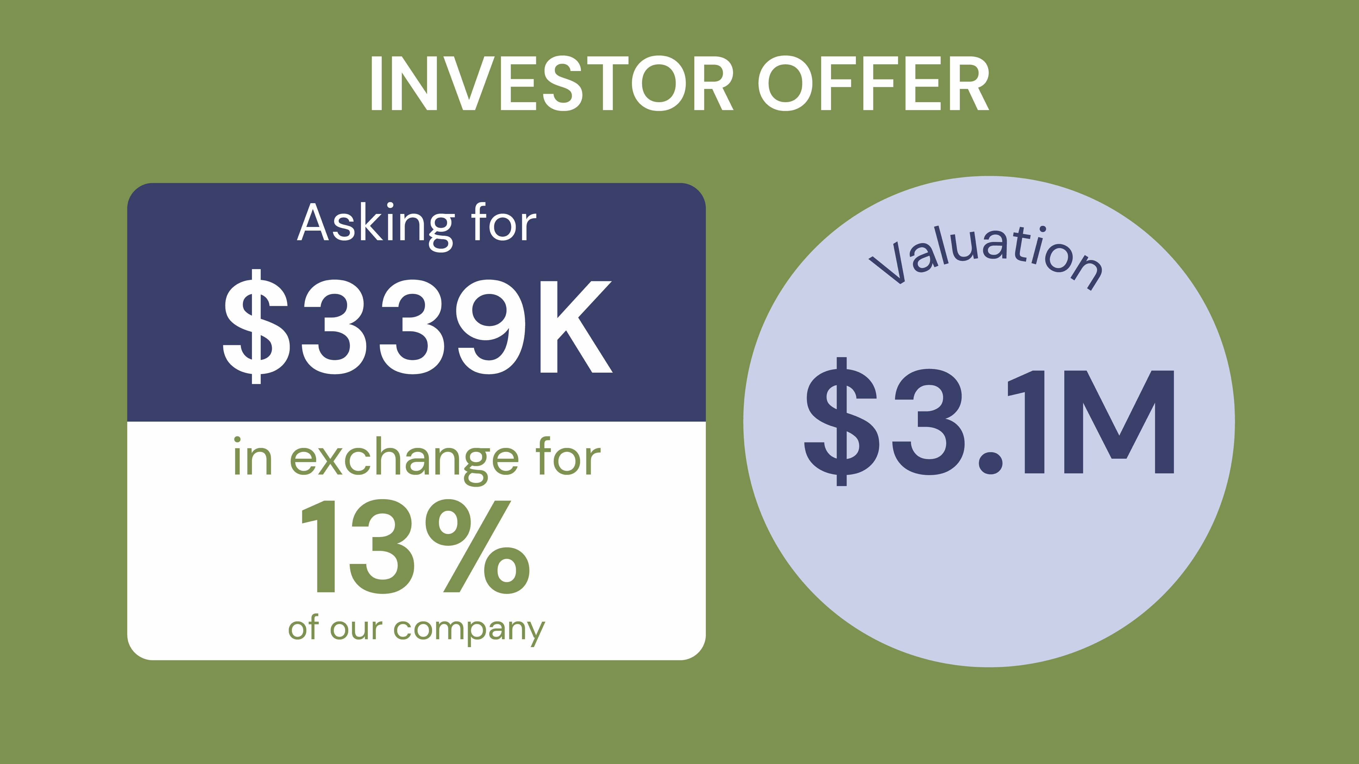

Slide 36


Slide 37

Component | Type | Source | Price Seller | Prototype Price
Microprocessor | ESP32 Nano | Arduino | $21 for 1 | $21.00
Servo Motor | 4Pcs SG90 9g | Amazon | $7.99 for 4 | $2.00
Beam-Break Sensor | ADA2167 | Adafruit | $2.95 for 1 | $2.95
Battery Life Sensor | Voltage Sensor DC | Amazon | $4.99 for 5 | $1.00
Switches | SLW-1276864-4A-D | Digikey | $0.83 for 1 | $0.83
Voltage regulators | MPM3610 | Adafruit | $6.95 for 1 | $6.95
Battery Pack | 6V Battery AA holder | Amazon | $6.99 for 4 | $1.75
Batteries | AA | Amazon | $9.99 for 24 | $0.42
Wires | MF,MM,FF 20cm | Aliexpress | $3.80 for 120 | $3.80
Breadboard | Half Breadboard | Adafruit | $4.95 for 1 | $4.95
Plastic | PLA | C3D | $0.02/gram for 417g | $8.34
 |  | Total | $79.68 | $53.98

Slide 38
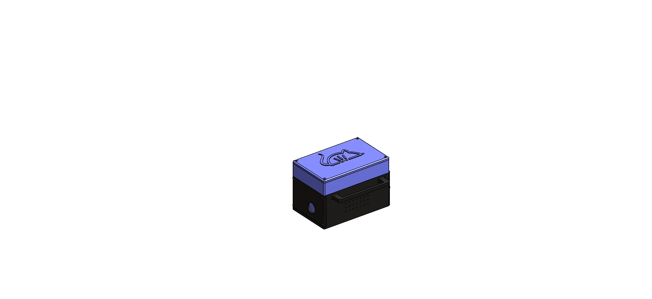

Slide 39

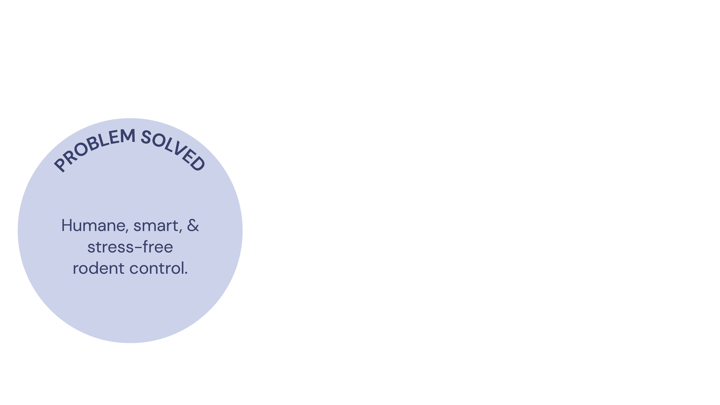
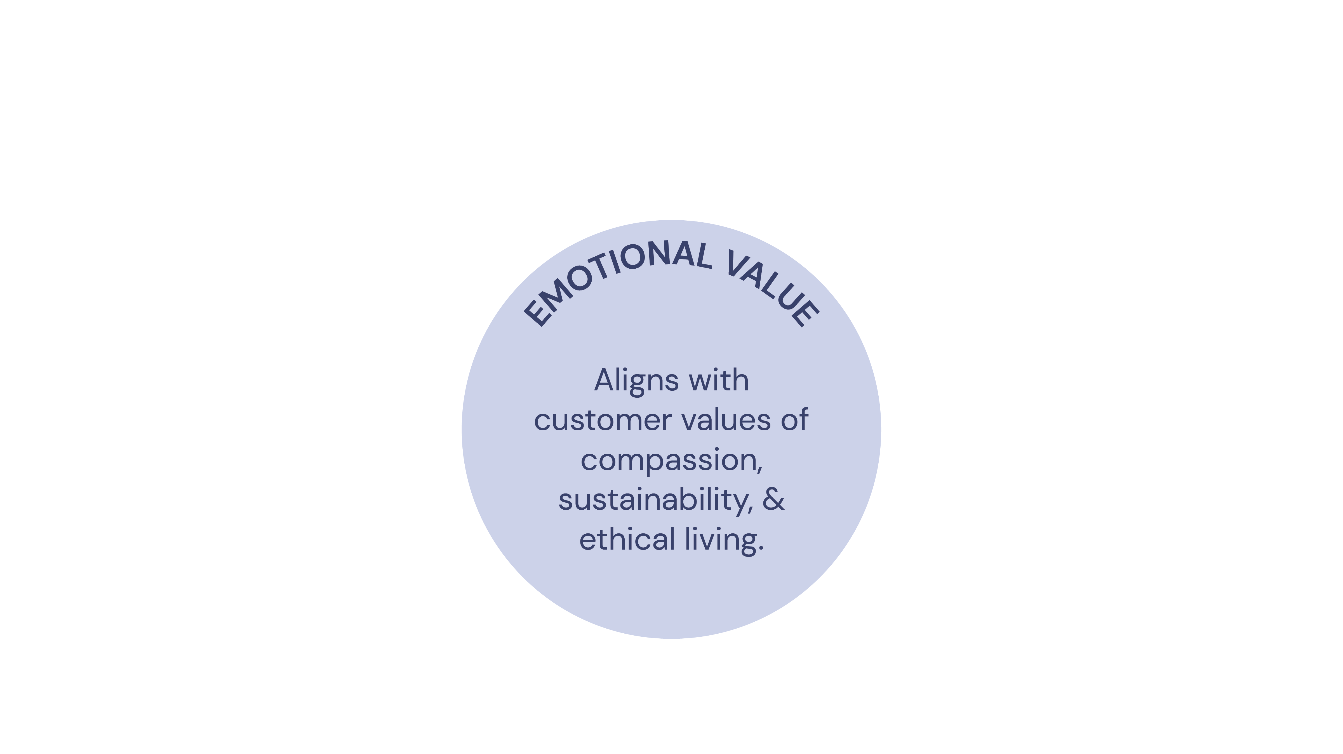
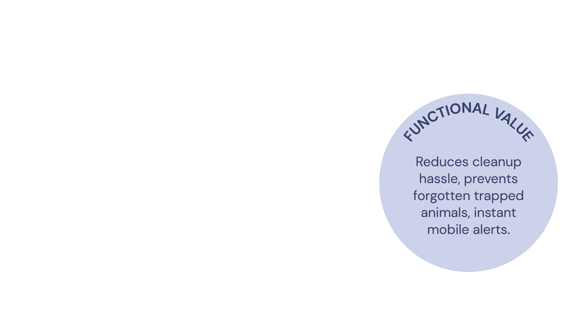

Slide 40

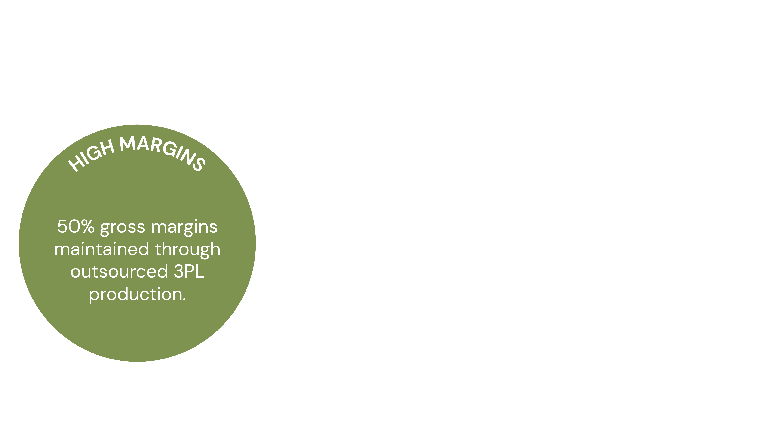
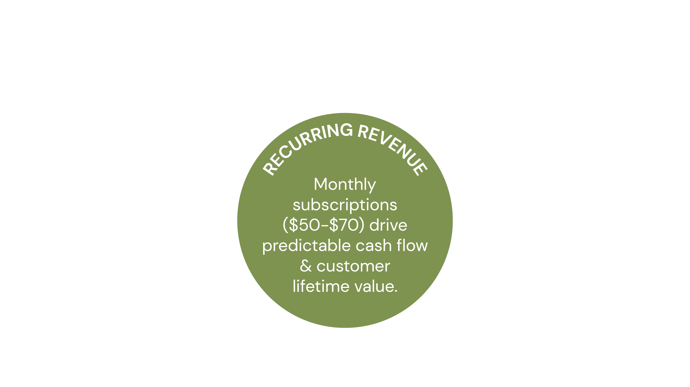
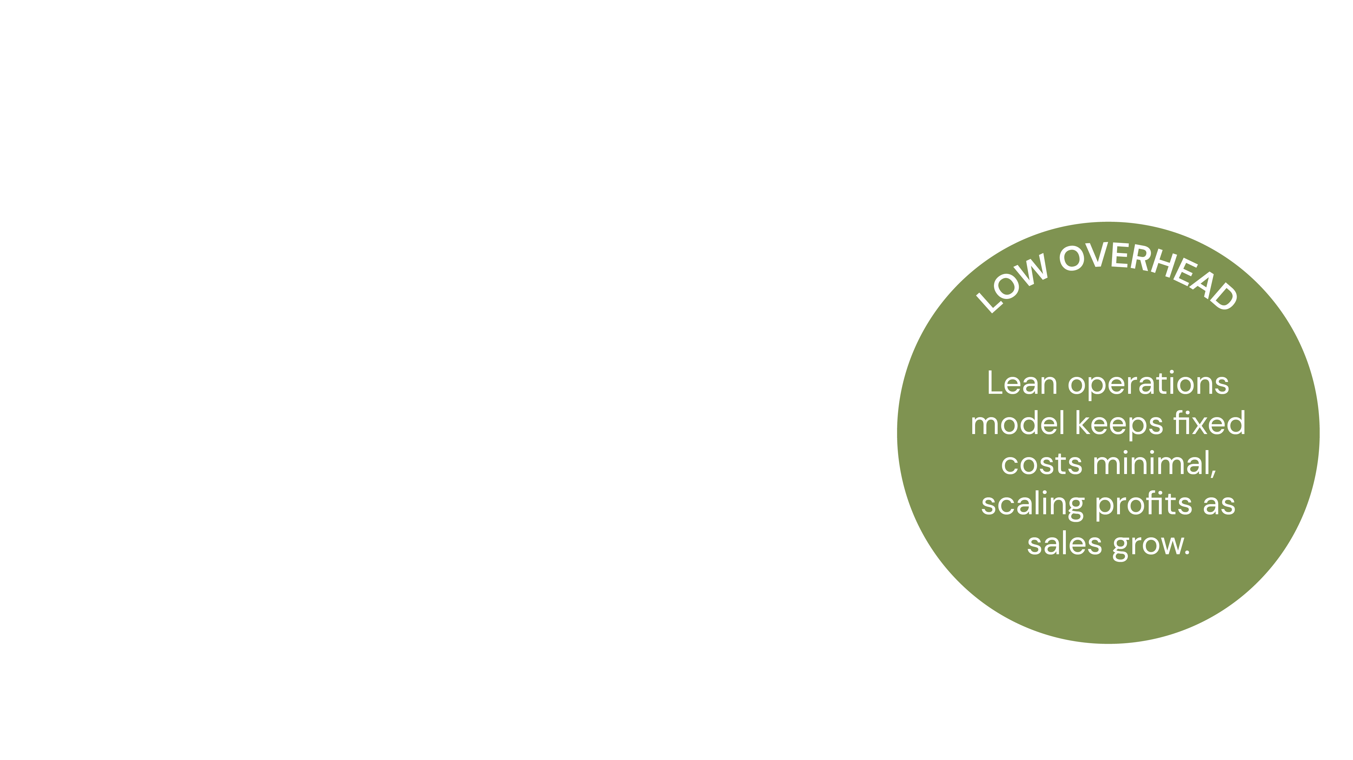

Slide 41
